Slide 1
IDEA ON HEALTHTECH
GPS tracking of Amulance
-PULKIT MOHAN (CSE- Ist Yr)
-TULA’S INSTITUTE, DEHRADUN

Slide 2
Basic Idea
So in todays world, people can keep track of everything just thorugh their smartphones. They can keep track of their orders, where they have reached and how much time will it take to reach us. We can keep track of nearly everything starting from food, groceries, clothes, appliances and cabs, trains etc.
But there is one thing which I have noticed we don’t have a system of tracking ambulances. I strongly believe that we should have a GPS tracking system for ambulance which should be available for common people.

Slide 3
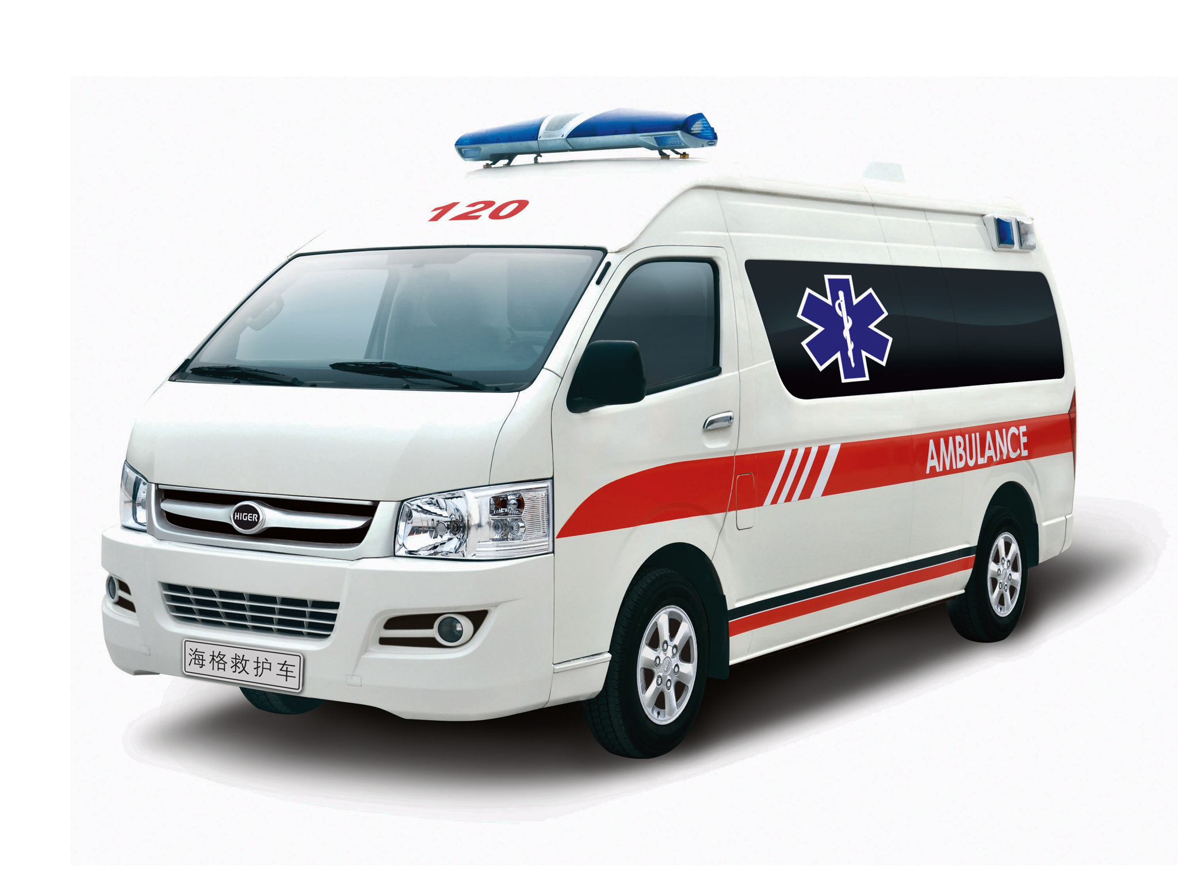

Whenever a accident occurs or someone is in need of ambulance, they call the ambulance service and they cannot explain the exact location of arrival or where the acciddent has occurred. So it would be very helpful if both the people and amulance could the GPS location of each other.
It would save a lot amount of time and be very helpful for a good cause.

Slide 4

Requirements for this Idea
As I am new to programming, I could not tell what are the complete needs for this project, but I can assure a individual can do this if he/she has the skill.
So I would like to give a brief list of requirements.
A GPS tracking code, for tracking the location of ambulance and GPS loaction of individual.
All the required permissions and access to the Googles GPS servers.
GPS tracking device installed in the ambulance.
(Do not recommend for mobile application for GPS tracking in ambulance’s driver as the phone battery could die or get stolen. If the GPS is installed in the ambulance, it would be connected to the battery and always tell the exact location of the ambulance. )

Slide 5
THANKYOU

